Slide 1
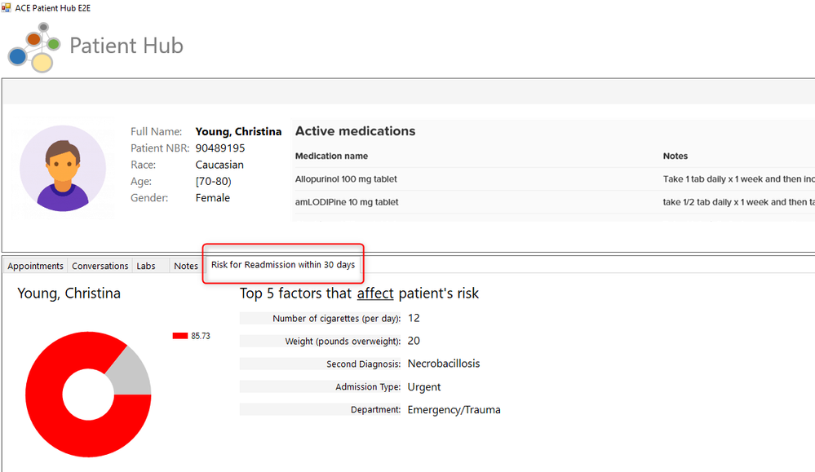
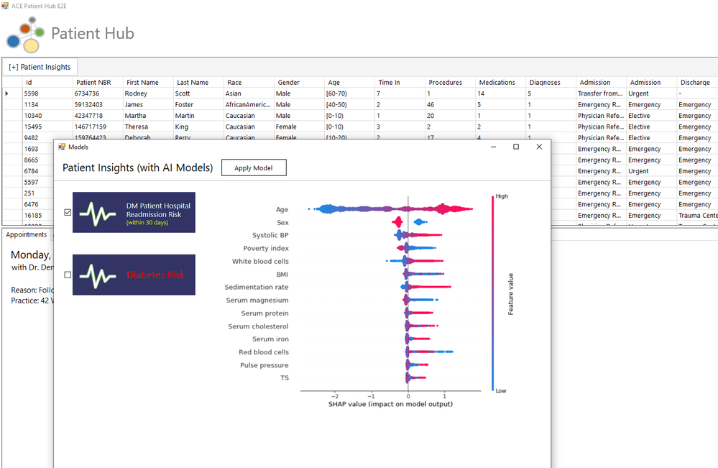
Microsoft AI Platform – Healthcare Machine Learning
Business Need
Microsoft wanted to demonstrate how AI and machine learning could be embedded into a realistic, end-to-end healthcare application to deliver more personalized insights from patient data. The goal was to show developers and healthcare partners how Azure Machine Learning could be used to predict outcomes such as hospital readmission risk and make those insights accessible to patients and clinicians.
What we Did
Partnered with Microsoft to design and build PatientHub, a healthcare demonstration application
Created distinct user experiences for patients, clinicians, and data scientists to highlight AI-driven insights
Integrated machine learning models using Azure Machine Learning to generate patient risk predictions
Built interfaces that allow patients and clinicians to view predictions and understand contributing factors
Enabled simple model deployment and management to support ongoing experimentation
Outcomes
Delivered a full-stack healthcare AI demo showcasing practical use of Azure Machine Learning
Demonstrated how predictive insights can be clearly presented to both patients and clinicians
Provided a reusable reference for teams building AI-enabled healthcare applications on Azure

